Slide 1
Cross Validation
It is a statistical technique used in machine learning to evaluate the performance of a model and reduce the risk of overfitting.
It helps ensure the model generalizes well to unseen data.
The idea is to partition the dataset into subsets, train the model on some subsets, and validate it on the others.
The process is repeated multiple times to obtain a robust estimate of the model's performance.

Slide 2
Key Concepts of Cross-Validation
Training Set: Used to train the model.
Validation Set: Used to evaluate the model's performance.
100 examples: 80% =80 →(train (80%)+validate (20%)) 20 test example
Testing Set: Separate from the training/validation set, used for the final evaluation (not part of the cross-validation process)
The test set serves as a final check to evaluate the generalization of the model after cross-validation is complete.

Slide 3
Types of Cross-Validation
Hold-out Validation: The dataset is split into a single training and validation set (e.g., 80% training, 20% validation).
The model is trained on the training set and evaluated on the validation set once
Simple but can lead to high variance
k-Fold Cross-Validation: The dataset is divided into 𝑘 folds (subsets).
The model is trained on 𝑘−1 folds and validated on the remaining fold.
This process is repeated k times, with each fold serving as the validation set once
The results (e.g., accuracy, F1-score) are averaged across all k iterations
Computationally expensive for large datasets and the choice of ‘k’ affects performance: k=5 or k=10 are common.

Slide 4
Types of Cross-Validation
Leave-One-Out Cross-Validation (LOOCV): Each sample in the dataset is used once as a validation set, and the rest are used for training.
Computationally expensive for large datsets but unbiased.
Stratified k-Fold: Ensures that each fold maintains the same distribution of target classes as the original dataset.
It is recommended when the dataset is imbalanced
Example: For a dataset with 100 samples, where 80 are Class A and 20 are Class B:
In regular k-Fold, the distribution might be uneven in some folds.
In stratified k-Fold, each fold will maintain the 80:20 ratio.

Slide 5
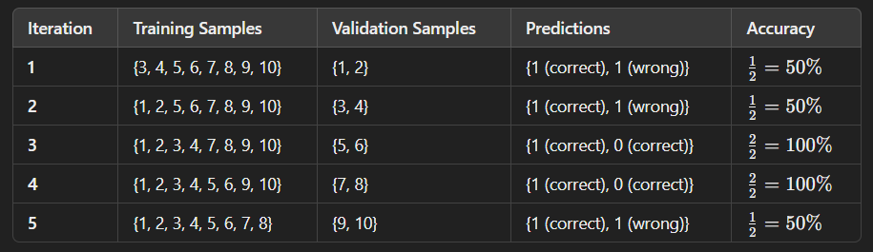
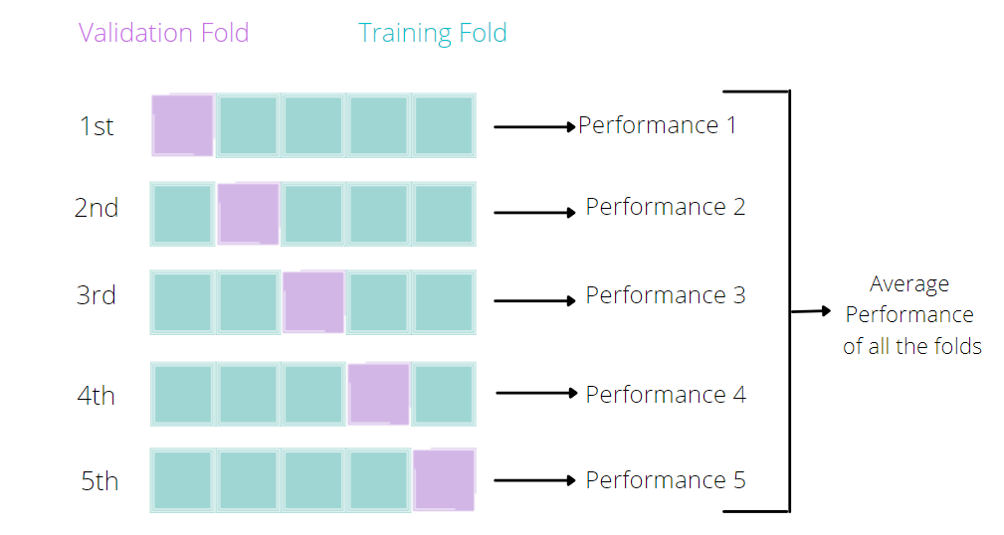
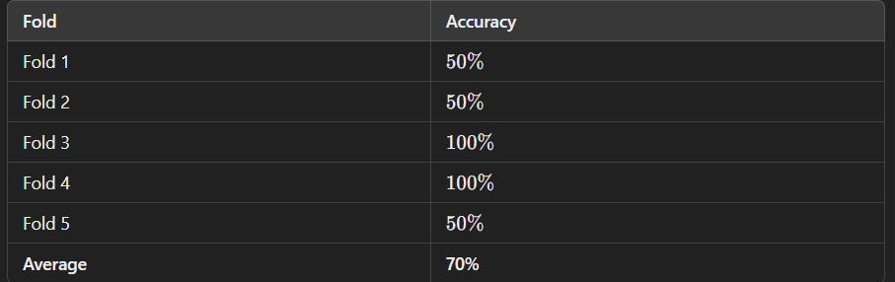
Example: K-Fold Cross Validation

Slide 6
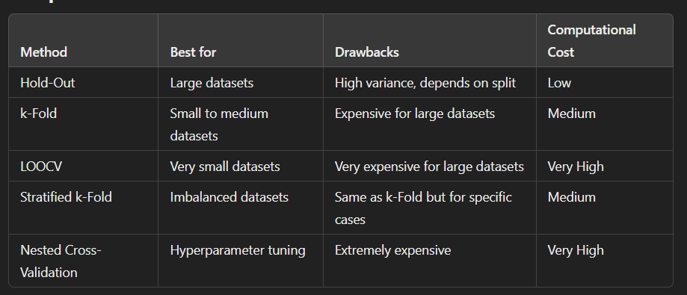
Comparison of Methods

Slide 7
Deep Learning

Slide 8
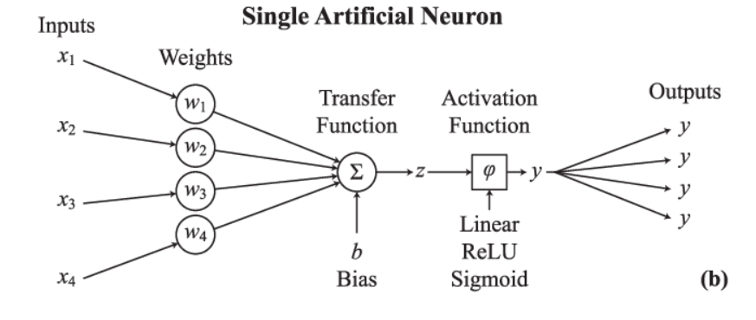
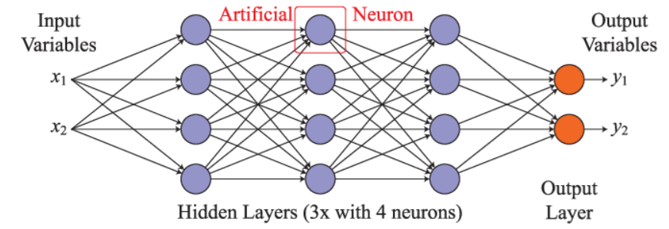
ANN Review
ANNs consist of layers of nodes, called neurons, where each node in a layer is connected to nodes in adjacent layers through weighted connections. The basic structure of an ANN involves:
Input Layer: This layer contains the input features fed into the network.
Hidden Layers: These layers perform computations to extract features and transform the input.
Output Layer: This layer provides the final predictions or outputs of the network.

Slide 9
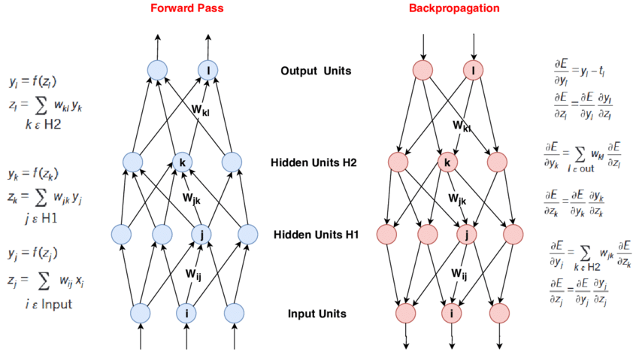
Forward Pass and Backpropagation

Slide 10

Activation Functions
Activation functions are essential components of neural networks.
They introduce non-linearity into the model, enabling it to learn complex patterns.
Without non-linear activation functions, a neural network would simply be a linear regression model, regardless of how many layers it had.
1. Sigmoid (Logistic Function)
Pros:
Smooth gradient, making it easy to optimize using gradient-based optimization algorithms.
Outputs values between 0 and 1, useful for binary classification problems.
Cons:
Vanishing gradient problem: When the input values are large or small, the gradients become extremely small, leading to slow or stagnant learning.
Not suitable for multi-class classification without modifications.

Slide 11

Activation Functions
2. Hyperbolic Tangent (tanh)
Pros:
Outputs range from -1 to 1, which is centered around zero, helping with faster convergence.
Cons:
Vanishing gradient problem: Still suffers from vanishing gradients for large or small input values.
Can saturate for extreme values, leading to slow convergence.

Slide 12

Activation Functions
3. ReLU (Rectified Linear Unit)
Pros:
Computationally efficient: Only requires a simple comparison to zero, leading to faster computation.
Does not suffer from vanishing gradients for positive input values, enabling better convergence.
Introduces sparsity by setting negative values to zero.
Cons:
Dying ReLU problem: Neurons can sometimes get stuck during training, always outputting zero if they enter the negative region and never update.
Can lead to unbalanced activation in deep networks, though variants like Leaky ReLU and Parametric ReLU (PReLU) address this.

Slide 13
Activations Functions
4. Leaky ReLU
Pros:
Addresses the dying ReLU problem by allowing a small, non-zero gradient when the input is negative.
Still computationally efficient, like ReLU.
Cons:
The performance depends on the choice of the small constant α alpha, which may need tuning.
May not be effective for all types of data or networks.

Slide 14
Activations Functions
5. Parametric ReLU (PReLU)
Pros:
Similar to Leaky ReLU, but the parameter α\alphaα is learned during training, which allows for more flexibility in fitting the model.
Helps to avoid the dying ReLU problem and adapt to different data distributions.
Cons:
Introduces an extra parameter (α\alphaα) that needs to be learned, increasing the model complexity.
May lead to overfitting in some cases if not regularized properly.

Slide 15

Activations Functions
6. Softmax
Pros:
Provides a probabilistic interpretation of the output, making it ideal for multi-class classification problems.
Normalizes the output to a probability distribution, where the sum of outputs equals 1.
Cons:
Sensitive to outliers in the input values, which can cause instability in training.
Computationally expensive due to the summation over all output classes.
Other activation functions are ELU (dying ReLU), Swish, GELU (deeper or complex networks) etc.

Slide 16
CNN (Convolutional Neural Network)
It is a class of deep neural networks that is primarily used to analyze visual data.
CNNs have been successful in a wide range of tasks including image classification, object detection, segmentation, and video analysis.
Their architecture is designed to automatically learn and extract features from images, leveraging a set of specialized operations like convolution and pooling.

Slide 17
Key Components of CNN
Convolutional Layer:
Extracts features from the input image by applying filters (also called kernels).
The convolution operation is performed between the filter (kernel) and the input image (or previous layer). The filter slides over the input in small steps, called strides, and performs an element-wise multiplication followed by summing the results.
Filters/Kernels:
Small matrices that detect specific features like edges, corners, or textures in the image. Filters are learned during the training process.
Stride:
The number of pixels the filter moves over the image in each operation. A stride of 1 means the filter moves one pixel at a time.
Padding:
Padding is added to the image to ensure that the convolution operation can be applied to the edge of the image. Padding helps retain spatial dimensions (in some cases, like "same" padding).

Slide 18

Convolutional Layer - Mathematical Formulation
For a given filter K and input image I, the output at position (i,j)is computed as:
where M×N is the size of the kernel K, and i and j are the pixel locations in the input image I.

Slide 19

Activation Function (ReLU)
Adds non-linearity to the model, allowing it to learn more complex patterns.
After the convolution, the output is passed through an activation function (commonly the Rectified Linear Unit, or ReLU), which outputs the maximum between 0 and the input value.

Slide 20
Pooling Layer
Reduces the spatial dimensions of the feature maps (output from convolution) while retaining important features.
Types:
Max Pooling: Selects the maximum value in each patch of the feature map.
Average Pooling: Takes the average value in each patch.
Stride: Pooling operates with a specific stride, typically 2, reducing the size of the output by a factor of 2.

Slide 21
Additional Convolutional & Pooling Layers
In a Convolutional Neural Network (CNN), additional convolutional and pooling layers are added to deepen the network.
These layers enable the network to learn more abstract and complex features as the data flows from the input layer to the output layer.
Each additional convolutional layer applies a new set of filters to the feature maps generated by the previous layer.
The depth of the feature map (number of channels) typically increases as we go deeper into the network.
Pooling layer reduces the computational cost by decreasing the size of the feature maps.
Provides translational invariance, allowing the model to recognize objects regardless of their position in the image.
Prevents overfitting by reducing the number of parameters in subsequent layers.

Slide 22
Fully Connected Layer (Dense Layer)
After several convolutional and pooling layers, CNNs typically end with one or more fully connected layers.
These layers connect every neuron to every other neuron, similar to traditional neural networks.
The output from the final convolution or pooling layer is flattened into a 1D vector, and passed through a dense layer to classify the image into different categories or perform other tasks.
The fully connected layer outputs the final classification or prediction.

Slide 23
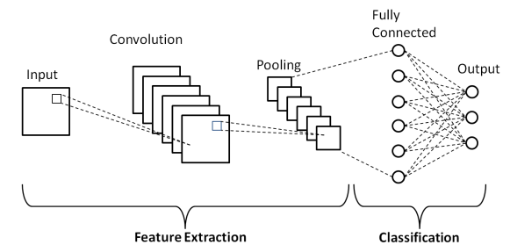
Block Diagram
CNN Architecture Overview:
CNN architecture involves the following sequence of layers:
Input Layer: The image is passed as input, typically with dimensions H×W×C (height, width, and channels).
Convolutional Layer: Detects features like edges, textures, etc.
Activation Function (ReLU): Adds non-linearity.
Pooling Layer: Reduces spatial dimensions.
Additional Convolutional and Pooling Layers: The network learns more abstract features as it deepens.
Fully Connected Layer: Outputs the class probabilities or predictions.
Output Layer (Softmax for classification): Provides the final output (e.g., the predicted class)

Slide 24

CNN Dimension Calculation
The formula for dimension calculation of the convolutional layer and pooling layer is:

Slide 25
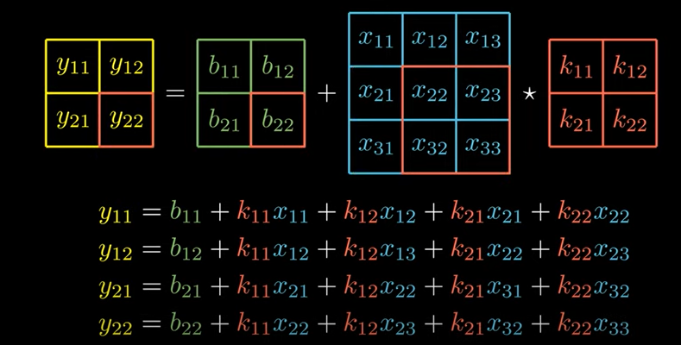
Convolution Operation - Explanation

Slide 26
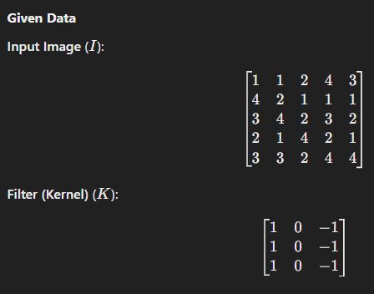
Example: CNN Convolution Operation
For this example assume the following: Stride=1
“valid” or no padding
Input (single channel) one filter (one kernel)

Slide 27
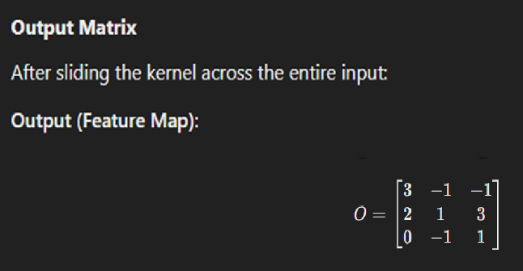
Output result

Slide 28
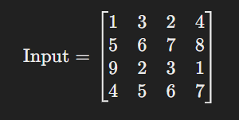
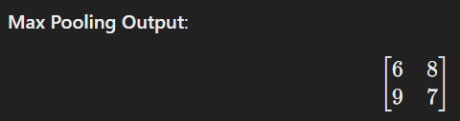
Max Pooling Example
For an example of input feature map given below:
Assume filter size: 2x2
Stride: 2
No padding
Pick maximum in the selected region

Slide 29
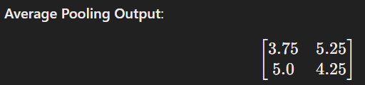
Average Pooling Example
For an example of input feature map given below:
Assume filter size: 2x2
Stride: 2
No padding
Take average of the selected region

Slide 30
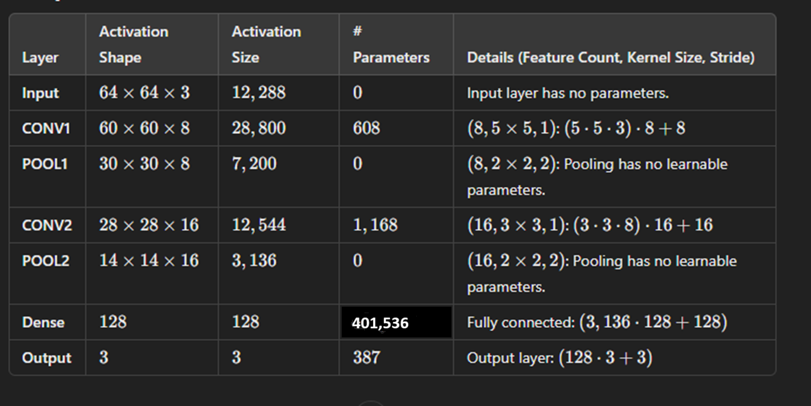
CNN Dimension Calculation
Notes:
# of parameters = filter size (row x col) x no. of current input channels x no. of filters + biases(equal to no. of filters)
You cannot change the number of filters in the pooling layer directly because it does not have trainable parameters or filters like a convolutional layer.

Slide 31
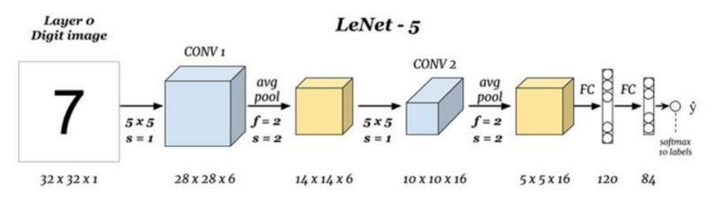
LeNet-5

Slide 32
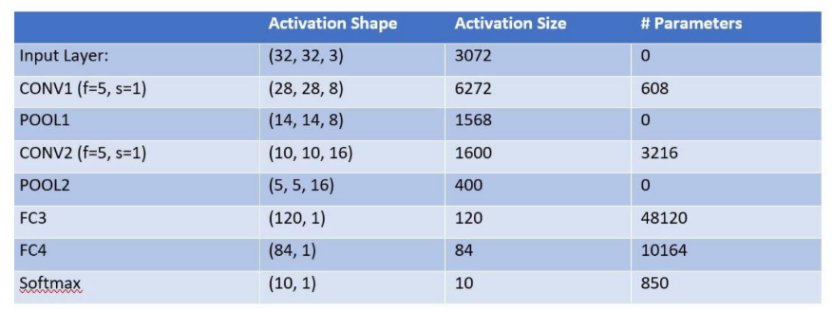
LeNet-5 Dimensions Calculation

Slide 33
CNN Detailed Notes
https://cs231n.github.io/convolutional-networks/

